Slide 1
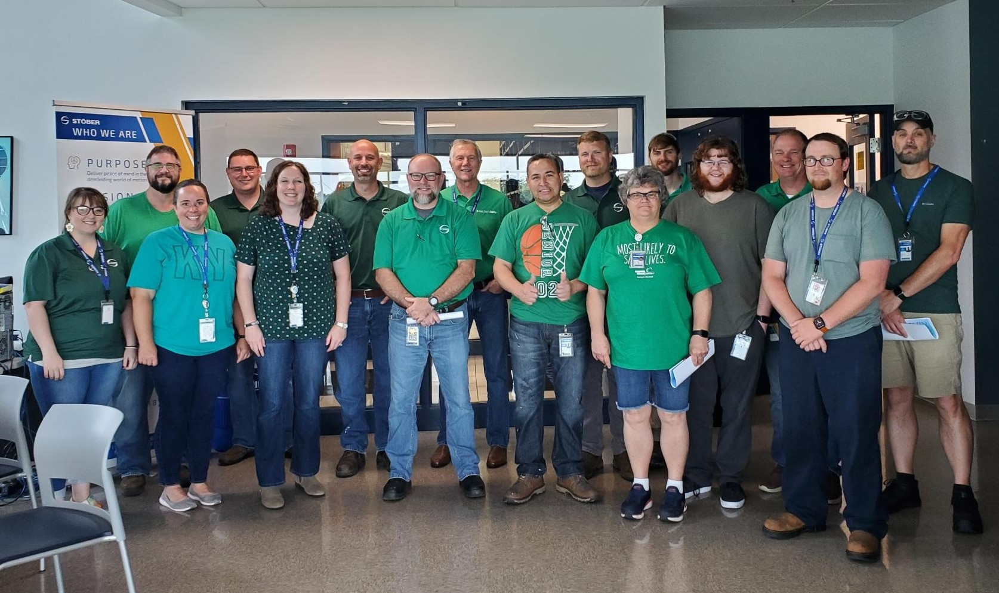
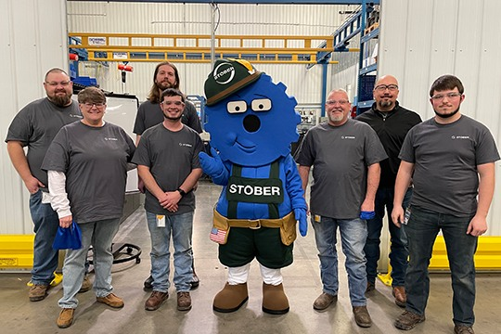
How does STOBER retain their employees?

Slide 2
People are like flowers
Each person is unique, has their own story, and requires different things to grow and thrive.
We are the gardener
The best and most beautiful gardens have the most variety!
Make sure you weed your garden

Slide 3
Hiring
I like to ask candidates: what are your expectations of a company?
Person #1: Respect and to be treated as a person
Person #2: I want to learn, grow, and innovate with this company
Person #3: I want to get paid a good wage and have good benefits
Who would you hire based on these answers?

Slide 5
Orientation
All employees go through orientation so that they can be ready for their first day of work! During orientation they…
Meet with the General Manager to discuss the culture of the company
Learn about the social covenant
Take Safety Training
Learn about their benefits, handbook policies, procedures, and are able to ask any questions they might have.
Given a tour of the campus
Instructed on how to dress, where to park, and all the nitty gritty things of starting a new job

Slide 6
Transformational Leadership
All STOBER employees go through 2 days of Transformational Leadership training. In this training they learn…
How to deal with conflict
STOBER’s social covenant
What to do when you realize that you made a mistake

Slide 7
All people come with baggage!
It is important to teach and guide employees to the expectations
Once they have learned the expectations, let them loose! Trust that the person can do the job you hired them to do.

Slide 8
Hands off Management
At STOBER we give our employees the freedom to work autonomously. Our employees are self-starters, in turn they are more engaged and willing to go the extra mile to ensure the job gets done, without being micromanaged!
Employees have the option of working from home or working in the office whenever they choose, majority of the time.
Employees are free to and encouraged to participate in work-based improvement projects or teams that engage them such as activities teams, wellness teams, and culture teams.

Slide 9
Listening
At STOBER Drives Inc., we strive to always listen to our employees and try to cater as much as we can to their wants and needs.
Employees are sent an annual survey to ensure their voices are being heard!
We also encourage open communication and facilitate a welcoming work environment so that all employees feel that they can ask questions, offer suggestions, or admit when they have made a mistake (because nobody’s perfect).

Slide 10
GAS Incentive Program
Works in 3 ways…
If someone is dissatisfied with their environment or it is just not a good fit for them, they can receive compensation to leave.
During their weekly team huddles, employees are asked to nominate others that have made a positive impact on the team. Those who are nominated can receive a variety of different rewards for their efforts.
Each Team Leader also receives a budget to spend on team building and overall fun things!

Slide 11
Physical, Financial, and Mental Wellness
We offer programs that help the WHOLE person.
Employees are free to choose to participate in the programs that most interest them.
We offer Dave Ramsey, books, and financial planners onsite to help employees
We offer gym memberships, fitness trackers, 5K and other reimbursements per event, as well as personal training
We waived the copayment for mental wellness in 2020 to help employees deal with COVID, loneliness, and other issues to help employees cope with all these changes

Slide 12
Mentorship
Each employee when they join the company and get through orientation are given a mentor

Slide 13
Apprentice and Pre-apprentices
We have a dedicated apprentice instructor onsite to teach and coach our apprentices and pre-apprentices

Slide 14
Leadership
Who you promote says volumes about your culture
Who are you promoting: compassionate leaders or micromanagers
We have a FLL (front line leader program)
The front line has a forum and platform to learn form one another with curriculum, objectives, and goals to achieve to make the run flawless
It’s based off a book/program called RIG-Run Improve Grow by Ray Attiyah

Slide 15
Pothole theory
Pothole theory
Listen and give feedback: that’s the way we do it here is not a good answer

Slide 16
Performance Reviews
Should be a way to identify strengths and weakness
A time to set goals
Celebrate accomplishments
Look at competencies to see if they are still relevant

Slide 17
Engagement
People quit people, they don’t quit companies
Do you have the right people and leaders in place to create the culture you want
Employees who are engaged are:
Innovative
Go above and beyond, give the other 1 degree
Are adaptable

Slide 18
Question
Questions

