Slide 1
Preparing for the Workforce
How the Kentucky Career Center can help serve you.

Slide 2
KY Career Center
The career center serves as a platform to help job seekers find suitable employment and obtain their goals. KCC partners with several different resources to help meet your needs and aspirations.
We offer Focus Career, Career Edge, and access to the WIN Career Readiness System and ACT WorkKeys system.
We partner with our local KCTCS college which is the Maysville Community and Technical College to help those interested in returning to school or earning a GED.

Slide 3
Where to begin?
Finding employment can be a struggle as far as knowing where to look for jobs, completing applications, and writing resumes and cover letters.
There are several resources available to look for work such as your local newspaper, online, advertisements at local resources, colleges, or career centers.

Slide 4
What am I interested in?
Personal Fulfillment
Try to focus on what you enjoy learning.
Consider educational opportunities-certificate, diploma, and degree options.
Try and think of your long term career goals.

Slide 5
KCC Job Search
The Kentucky Career Center offers Focus Career which gives you more options and bases the search from your resume and work and education experience.
Benefits include:
Free account setup
Access to labor market information
Build your resume and send it directly to employers through the website

Slide 6
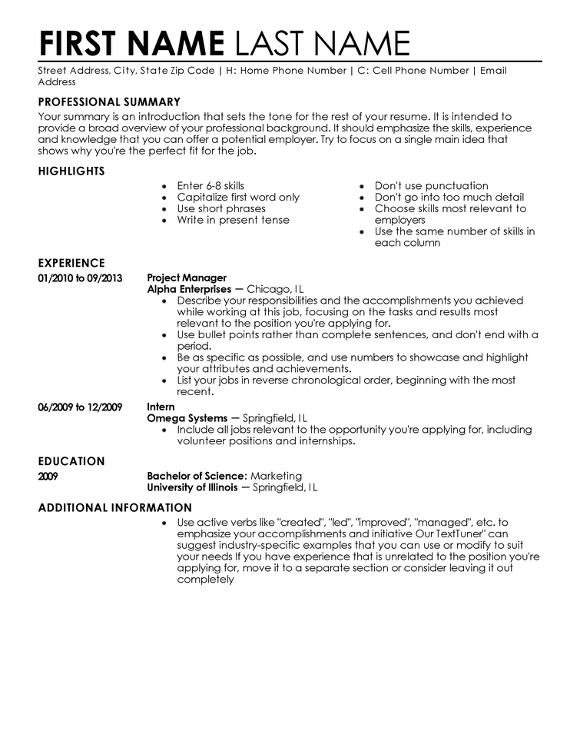
Resumes Why are they important?
Resumes are important because it gives the employer a representation of who you are, your skills, education, and overall experience.

Slide 7
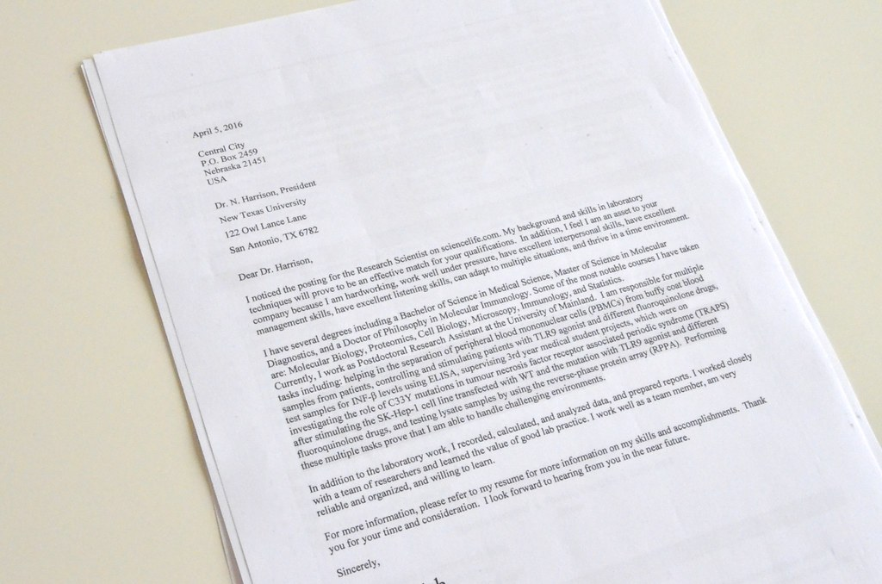
What is a Cover Letter?
A cover letter is an introduction to the employer to highlight your skill set, achievements, and prove that you can succeed in the position for which you are applying.

Slide 8
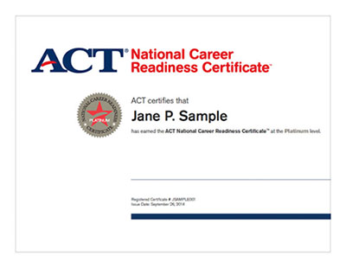
Tests Offered Through KCC
Test for Adult Basic Education- this tool is used to determine adult basic literacy and math skills. Test determines whether individuals can read technical information and complex manuals or comprehend college level books and manuals.
Worldwide Interactive Network Career Readiness System- this courseware is an online workforce training program which provides skill development in career readiness and essential skills. The Essential Skills courseware reinforces attitudes, behaviors, and applied competencies which are the soft skills most critical to success. The Career Readiness courseware is instruction in applied math, reading for information, and locating information. The user can take the exam to earn their KY Essential Skills Certificate.
ACT- this system helps prepare users to take the exam for the National Career Readiness Certificate which is offered at our center. The user must complete the three assessments in applied math, workplace documents, and graphic literacy. The NCRC is a portable, evidence-based credential that certifies the essential skills for workplace success.

Slide 9
Career Edge
Career Edge is another wonderful tool that is completely free.
With Career Edge you can take different assessments to help discover your career interests and skills.
You can practice completing applications, mock interviews, and completing your resume and cover letter.
You also have access to life skills training materials such as financial management, study skills, conflict resolution, etc.

Slide 10
Workforce Innovation Opportunity Act
The KY Career Center has staff members to assist with WIOA. WIOA stands for Workforce Innovation Opportunity Act it’s a federal law that helps those who are either in the workforce, returning to school, or not yet in the workforce find suitable employment.
Eligibility requirements apply and are related to age, income, work circumstances, and education.
WIOA offers on-the-job training, apprenticeships, a scholarship program, career counseling, etc.

Slide 11
KY Career Center Overview
The KY Career Center serves as a platform to help job seekers with employment services and provide additional assistance and guidance.
The KY Career Center helps job seekers find suitable employment, provide assistance with personal portfolios, and provide labor market information.
The KY Career Center is here to serve those within the community. The KY Career Center partners with several agencies who can provide additional assistance and resources as necessary.

Slide 12
Questions?

