Slide 1
Ashley McCarty
Senior Manager of Community Engagement

Slide 2
Our VOA Core Values

Slide 3
Freedom House
A nationally-recognized model for recovery for pregnant and parenting moms.
The first of only seven programs – and the only one in KY – to be certified by the rigorous American Society of Addiction Medicine, in the pilot phase of the Medicaid ASAM certification roll-out.

Slide 4
Employment Services for
People in Recovery
Job placement & follow-up
Job training and search assistance
Career counseling & mentoring
Classroom training
Financial assistance
Life skills support services

Slide 6
According to the Crime & Justice Policy Institute, “employment fills a vital need for most individuals; it provides income, social connection, and feelings of societal contribution and self-worth.”
10 Jennifer Fahey, Cheryl Roberts, Len Engel. Crime & Justice Institute. “Employment of ExOffenders: Employer Perspectives.” (October 31, 2006)

Slide 7
While 2.3 million people are imprisoned in the United States, 95% of people in state prisons will re-enter our communities at some point.
Timothy Hughes and Doris James Wilson “Reentry Trends in the U.S.,” Bureau of Justice Statistics,
https://www.bjs.gov/ content/reentry/reentry.cfm.

Slide 8
COMMUNITY VALUE OF HIRING PEOPLE WITH RECORDS
Strengthen the local economy by reducing unemployment
Increase economic self-sufficiency, which supports strong and healthy families
Improve the health and safety of the community with lower rates of crime and recidivism by increasing employment of those with prior convictions
Safer Found., Improving Public Safety, Reducing Incarceration Rates & Costs By Lowering Recidivism in Illinois, (Aug. 2014), http://www. saferfoundation.org/files/documents/FINAL-White-Paper---ImprovingPublic-Safety--Reducing-Incarceration-Rates--Costs-by-LoweringRecidivism-in-Illinois-8-8-14--2-.pdf.

Slide 9
Employment is the #1 most important factor for decreasing recidivism.
Mark T. Berg &amp; Beth M. Huebner, Reentry and the Ties that Bind, 28 Justice Quarterly 382 (2011),
http://www.tandfonline.com/doi/abs/10.108 0/07418825.2010.498383?journalCode=rjqy20#preview.

Slide 10
A lack of stable employment increases the likelihood that an individual will return to jail or prison;
research has found that joblessness is the single most important predictor of recidivism.
Justice Center, National Reentry Resource Center, “What Works in Reentry Clearinghouse: Employment,”
The Council of State Governments, n.d.: https://whatworks.csgjusticecenter.org/

Slide 11
U.S. Equal Employment Opportunity Commission
Employers must consider the background of the job applicant, not just the record.
The nature of the offense
The nature of the offense
Whether the individual’s record is directly related to the job
Any evidence of rehabilitation-Education/Training
Evidence of work history
Employment or character reference

Slide 12
Research by economists confirms that hiring people with records is simply “smart business.”
Higher retention rates
Lower turnover
More loyal than the general workforce
Daryl Atkinson, “The Benefits of Ban the Box,” The Southern Coalition for Social Justice, 2014,
http://www.southerncoalition.org/wp-content/uploads/2014/10/BantheBox_WhitePaper-2.pdf

Slide 13
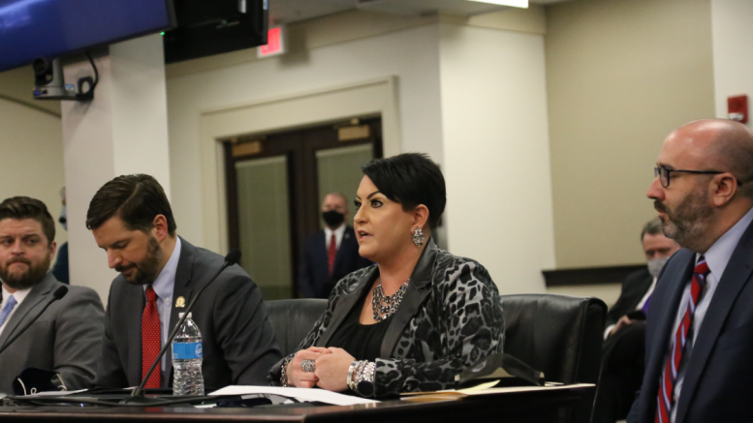
Recovery Ready Communities
House Bill 7, filed by Rep. Adam Bowling (R-Middlesboro), establishes a framework for communities to become “Recovery Ready,” bringing much needed consistency to local substance use prevention, treatment and recovery efforts.
House Bill 7 was signed into law by Governor Beshear on March 23, 2021.
Notes:
Quote? Or no quote? If quote, which one? Adam Bowling or Gov. Beshear?

Slide 14
HB 7
Established the Advisory Council for Recovery Ready Communities;
Outlined the membership and duties assigned to the Advisory Council including adopting a Recovery Ready Community Certification Program; and
Authorized the Kentucky Office of Drug Control Policy to promulgate any administrative regulations that are necessary to advance the Advisory Council’s statutory duties.

Slide 15
Recovery Ready Community Certification Program
The purpose of the certification program is to provide a quality measure of a city's or county's substance use disorder recovery programs and to assure citizens and businesses that a city or county is committed to ensuring the availability of high-quality recovery programs in its community that can help lead to a highly skilled community workforce.

Slide 16
Recovery Ready Communities Objectives
Reduce community stigma around substance use disorder, treatment, and recovery;
Empower communities to take inventory of existing substance use disorder prevention, treatment, and recovery resources available to its citizens;
Allow communities to use the inventory of recovery services to identify gaps in the existing system allowing them request resources to fill those gaps; and
Increase “recovery capital” at the individual, family, and community level.

