Slide 1
Workforce Recovery Program
Ryan Bowman, Workforce Recovery Program Manager
Kentucky Chamber of Commerce Foundation

Slide 2
Notes:
Services for Kentucky employers, employer-facing staff and partners to help develop promising practices in response to OUD/SUD epidemic
Six Employer Resource Networks (ERN)
Provide case management, and support services to assist current employees, and citizens in recovery who are seeking (re)employment and training
Job Entry and Retention Support Specialists at each comprehensive Kentucky Career Center to assist with job placement
Embed Success Coach within each ERN to ensure success of job placement for both
Reentry Employment Program Administrators
Provide employment support services upon reentry
At Probation and Parole offices in Louisville, Lexington, Eastern and Northern KY
Kentuckiana Health Collaborative
Opioids and the Workplace: An Employer Toolkit for Supporting Prevention, Treatment, and Recovery
Developed to help employers support their employees and their dependents in prevention, treatment, and recovery from opioid use and opioid use disorder.

Slide 6
The Path to Transformational Employment
Organizational Culture Change
ASSESSMENT
Benefits
(Re)Employment
TRANSFORMATIONAL EMPLOYMENT
HR Policies
Training for Mgmt, HR, Staff
Notes:
Services for Kentucky employers, employer-facing staff and partners to help develop promising practices in response to OUD/SUD epidemic
Six Employer Resource Networks (ERN)
Provide case management, and support services to assist current employees, and citizens in recovery who are seeking (re)employment and training
Job Entry and Retention Support Specialists at each comprehensive Kentucky Career Center to assist with job placement
Embed Success Coach within each ERN to ensure success of job placement for both
Reentry Employment Program Administrators
Provide employment support services upon reentry
At Probation and Parole offices in Louisville, Lexington, Eastern and Northern KY
Kentuckiana Health Collaborative
Opioids and the Workplace: An Employer Toolkit for Supporting Prevention, Treatment, and Recovery
Developed to help employers support their employees and their dependents in prevention, treatment, and recovery from opioid use and opioid use disorder.

Slide 8
Kentucky Transformational Employment Program
Created to foster economic opportunities to individuals with a history of substance use disorder while encouraging employer participation in potential treatment programs for employees or potential employees.
Under Kentucky law (KRS 222.215), employers shall not be liable for a civil action alleging negligent hiring, negligent retention, or negligent supervision for a negligent act by the employee as a result of the employee's substance use disorder under KTEP.

Slide 9
Kentucky Transformational Employment Program
Support people with substance use disorders
Facilitate access to substance use disorder treatment
Increase the number of employable individuals in Kentucky
Improve talent retention

Slide 10
Kentucky Transformational Employment Program
84 Businesses
15,000+ Employees Impacted

Slide 11
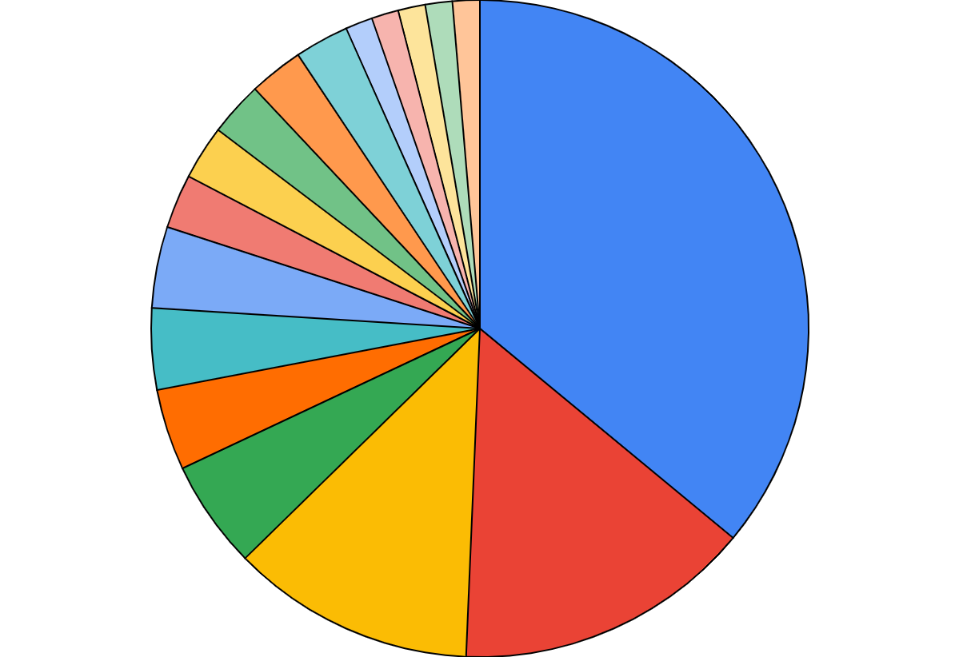
Kentucky Transformational Employment Program
KTEP NETWORK
Top 3 Industries
Manufacturing – 38%
Healthcare – 14%
Business Services – 12%
KTEP NETWORK
Top 3 Industries
Manufacturing - 37%
Healthcare - 14%
Business Services - 11%

Slide 13
Thank You!
Ryan Bowman
Workforce Recovery Program Manager
Kentucky Chamber Foundation
rbowman@kychamber.com
(606) 362-7713

