Slide 1

Mock
Interview
Star method

Slide 2
First Impressions
Your success in an interview can depend on your appearance and the interviewer's first impression of you. Research indicates that, on average, an interviewer decides to hire in just 5½ minutes. If the first impression is not positive, it will be difficult to change the interviewer's mind during the rest of the interview.
Be punctual. Arrive 10 minutes early to allow yourself time to collect your thoughts. Take the opportunity to observe the work environment. Keep your eyes and ears open.
Look professional—neat, clean, and well groomed. Select clothing for the type of organization interviewing you. If in doubt, be conservative. It is also advisable to keep fashion accessories to a minimum, to avoid wearing strong scents, and to turn off devices such as cell phones and electronic organizers.

Slide 3
Know the Company/Organization
You should be familiar with the position and the organization so that you can demonstrate your interest in and match for the job. Refer to the research notes you made as you reviewed print and online materials, spoke with people about the position, and prepared your resume and cover letter.
A commonly asked interview question is "What do you know about our company?" If you are unable to answer this question effectively, employers will see this as a sign of lack of planning or interest.

Slide 4
Research the Employer
Thoroughly research the organization to impress those with whom you meet and discuss your alignment with the company mission/vision and core values.
Suggested information to research:
• Key people in the organization • Size of organization • Location of facilities • Structure of organization • Types of clients • Product line or service • Potential markets • Stock and assets information • Competition • Training provisions • Recent news items
You can find this information in the following places:
• Company website • Public Relations • Glassdoor.com • Other employees • LinkedIn • Company Brochures

Slide 5
Behavior-Based Questions
Behavior-based interviews elicit information about how you have performed in the past, because past behavior is a good indicator of how you will function in the future. Interviewers develop their questions around the traits and skills they consider necessary for succeeding in a position or organization.
These questions usually begin with phrases such as:
• Tell me about a time when… • Describe a situation in which… • Recall an instance when… • Give me an example of…

Slide 6


Some applicants find the format of these questions difficult to understand and have trouble responding. However, if you have done your research and prepared for the interview, you will have work, academic, and life experiences ready to share. You can prepare for behavior-based accomplishments, abilities, and show how you are a good match for the position. Be certain to tell the truth, get to the point, stay focused, turn negatives into positives, and be consistent with your responses.

Slide 7
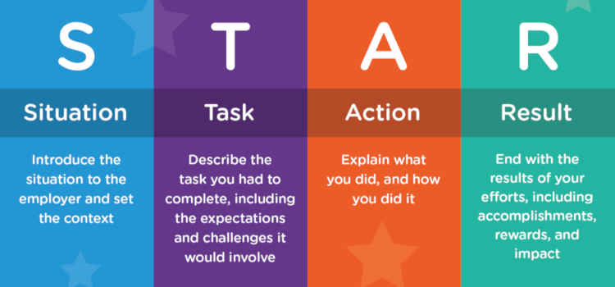
Star method
The S.T.A.R. method is a process used by many recruiters and employers to interview and assess applicants efficiently.
Even if a particular employer is not utilizing this method they will likely be using something akin to it.
So, to the applicant it is nothing but beneficial to learn how the S.T.A.R. method works
Situation - This is where you describe the situation and provide the interviewer with context
Task - What was your role in this situation? Explain what your duties were and what was expected of you at the time
Action - How did you carry out your task/s? Did you go out of your way to fulfill your duties or do more than you initially had to?
Result - This is the conclusion of your answer and story. Explain what results your actions had and if the situation was solved successfully or not. The use of numbers and data is a bonus.

Slide 8
STAR Method Answer Example
Now that we’ve got the theory all cleared up, let’s get down to practice & show you how the STAR method really works.
Let’s take one of the most common behavioral interview questions as an example:
“What is your greatest achievement?”
A good answer should look something like:
Situation - “Hmm… well, after graduation I worked for a year as an assistant to Company Y’s marketing director. We had a meeting with a potential client this one time and I was supposed to meet my boss straight to the location of the meeting. On my way there she called me and told me she was headed to the hospital as a family member of hers had had an accident.”

Slide 9
STAR Method
Task - “She asked me if I could carry on the presentation by myself and if not, I could cancel the meeting. I’d assisted my boss while she made the presentation, but I wasn’t prepared to deliver it. I was only supposed to help with setting up the place and carry the documents.”
Action - “Nevertheless, I like a challenge and I was confident I could do it so I agreed to hold the meeting.”
Result - “The presentation not only went well, but the client actually hired our company. My boss was more than happy. She gave me a raise and eventually became more of a mentor than a boss.”

Slide 10
STAR Method Interview Question Examples
Tell me about a time when you were faced with a challenging situation. How did you solve it?
Do you usually set goals at work? If yes, could you give me an example of a goal you had and how you achieved it?
Give me an example of a time you made a mistake at work.
Have you ever faced conflict with a coworker? How did you resolve the situation?
Tell me about a time when you handled the pressure well.
Was there a time when you had to be very strategic in order to meet a goal?
Give me an example of a situation when you showed initiative and took charge of a situation.
Tell me about a time when you went above and beyond your duties for a job or task.
Did you ever have to correct one of your superiors when they were wrong? How did you approach that situation?
Have you ever had to work under a tight deadline?

Slide 11

Dress to Impress

Slide 12
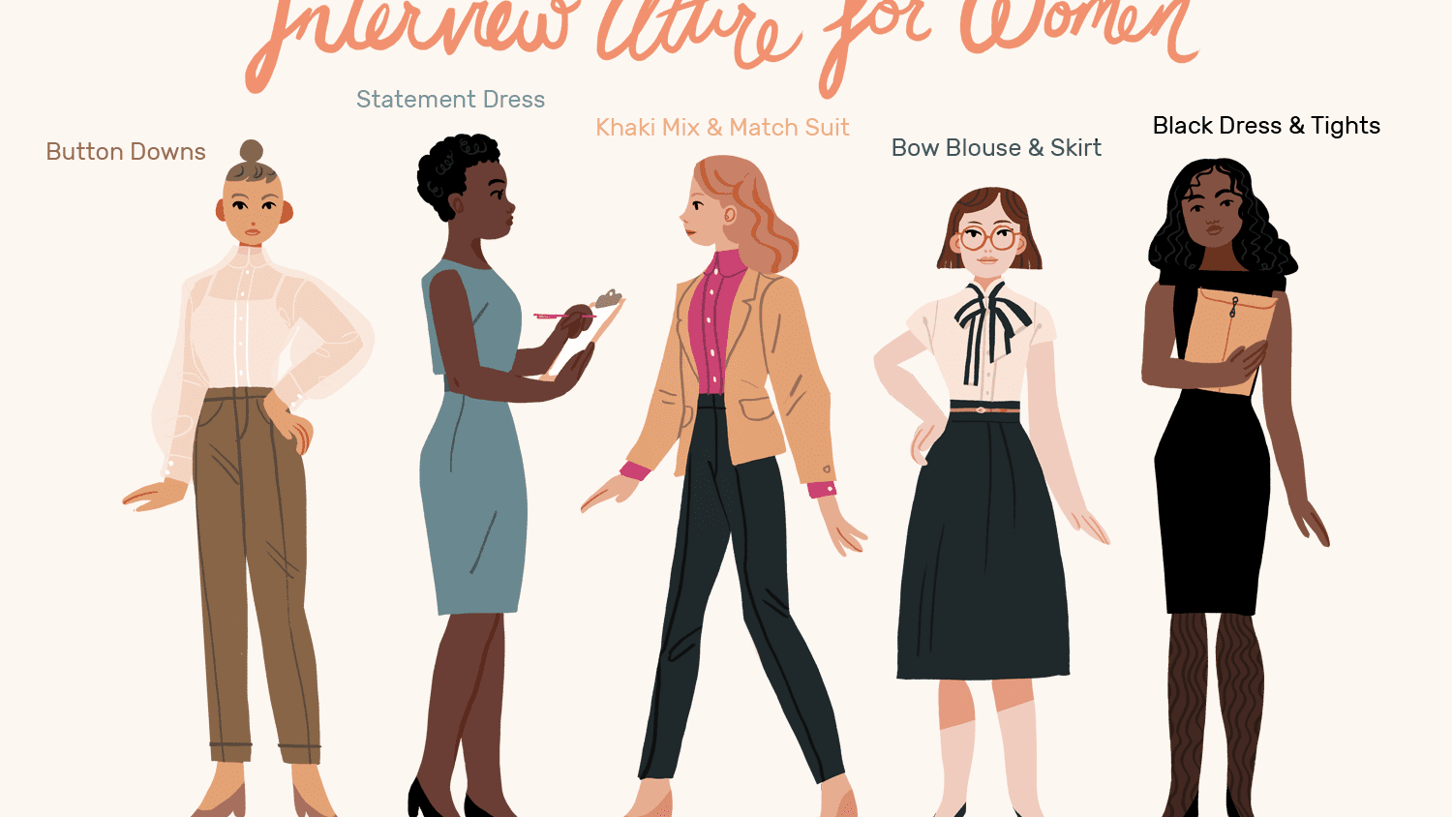

Slide 13
Questions you should ask at the end of every job interview
What are the most important things you’d like me to accomplish in the first three months if I am hired for this position?
Is there anything at all that you’d like me to clarify for you?
How do you see my skills and experience fitting with the needs of your company?
What are the prospects for growth in this job?
What do you enjoy most about working here?
How is performance typically measured and reviewed?
When do you expect to be making a hiring decision?
May I follow up with you to find out your decision? (Ask for their business card. This way you’ll have their information to follow up and to write a thank you note after the interview.)

Slide 14
Review
Dress to impress and project a positive attitude. First impressions mean a lot in an interview
S.T.A.R. Method
What to know prior to an interview and how to prepare
What questions you should ask as an interviewee
What to say and more so what not to say

Slide 15
