Slide 1
Kentucky’s Progress & Potential: Five Years of Pro-Growth Policy Wins
Ashli Watts, President and CEO
Kentucky Chamber of Commerce
Notes:
Intro & holding slide
Quick overview of the presentation

Slide 2
Five Years of Pro-Growth Policy Wins
Tax Reform (2018, 2019, & 2022)
Workers’ Compensation Reform (2018)
Right to Work (2017)
Unemployment Insurance Taxes and Benefits Reform (2021 & 2022)
Notes:
The past five years has seen a transformation in pro-growth economic policy in the state of Kentucky
We have seen dozens of critical pieces of legislation implementing major solutions to some of the Commonwealth’s greatest challenges
There are four areas in particular where we have seen some of the most important changes when it comes to growing Kentucky’s economy
Quick summary of tax reforms bills, workers’ comp reform, right to work, and the UI bills of 2021 and 2022

Slide 3
Measuring the Impact on Kentucky’s Economy and Business Community
Notes:
What impact are these policies having on Kentucky’s economy? This is actually a very difficult question to answer.
Assessing the full impact of these policies will take a lot of time. Some of them, in fact, have not even gone into effect yet.
Moreover, it’s often very difficult to tie a specific policy or piece of legislation to changes in the economy.
Complicating all of these factors is, of course, COVID-19 and the national economy, which has been on a roller-coaster ride ever since 2020, with a major recession occurring in 2020, followed by recovery, and followed by an unprecedented workforce shortage, rampant inflation, and another potential recession.
Nonetheless, there are a few metrics we can look at to suggest that Kentucky’s economic competitiveness has really started to turn a corner.

Slide 4
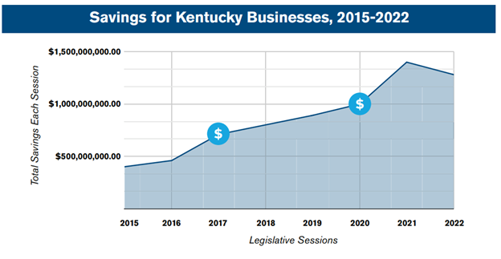
Direct Savings for Employers
Notes:
We can start by looking at some of the Chamber’s own data.
Discuss our Savings for Business data from the annual RFB report
The 2017 session is when we passed the half a billion mark
2020 saw $1b in savings

Slide 5
New Private-Sector Investments
2021: $11.2 billion
2017: $9.2 billion
Notes:
As the Governor has stated, Kentucky’s economy is truly “on fire” and we’ve seen an unprecedented level of investments coming into the state, including investments like the Ford Battery Plant (maybe mention local developments when possible)
In the past five years, we have seen two annual records set for the largest amount of announced private-sector investments in the state: $11.2 billion in 2021 and $9.2 billion in 2017

Slide 6
Kentucky’s Economic Recovery
Notes:
Another metric we can look at is the speed of Kentucky’s economy from the COVID pandemic.
In the initial months of the pandemic, Kentucky lost nearly 300,000 jobs. As of April of this year, we have recovered about 95 percent of these jobs: 284,000 jobs in about 25 months – that outstanding growth
This is roughly in line with the United States as a whole and the third fastest recovery rate in our region
This recovery says a lot about the resiliency of Kentucky’s economy, and the fact that we outpaced the recoveries of states like Missouri, Ohio, and Virginia is something we should be proud of.
We’ll talk more about Indiana and Tennessee momentarily

Slide 7
The Impact of Kentucky Tax Reform
Reforms of 2018 and 2019
Graduated Income Tax > Flat Income Tax
Income Tax Reduction 6% > 5%
Reforms to Corporate Tax Code
Expansion of the Sales Tax Base
Reforms of 2022
“Revenue Triggers” to Phase Out the Individual Income Tax
Expansion of the Sales Tax Base
Notes:
The overall competitiveness of our tax code is where Kentucky has perhaps seen the greatest transformation
Tax reform is a journey, not a destination; and Kentucky started this journey in earnest in 2018 and 2019 with two major reform packages that did several things:
They removed our graduated individual and corporate income tax system and replaced it with a flat tax
Whereas we previously had a graduated income tax ranging from 2 percent to 6 percent, the reform packages instituted a flat 5 percent income tax
Major reforms were made to our corporate tax code and the sales tax base was expanded
Another reform package was passed in 2022 that pushed things even further. House Bill 8 implemented a plan to fully phase out the state individual income tax by connecting future rate reductions to certain revenue triggers – savings and revenue goals for the state

Slide 8
The Impact of Kentucky Tax Reform
Notes:
These reforms have earned Kentucky’s national recognition and significantly improved Kentucky’s economic competitiveness
Proof of this can be seen in Kentucky’s national tax competitiveness rankings. Every year a nonpartisan organization called the Tax Foundation ranks every state for the competitiveness of their tax codes. The Tax Foundation looks at dozens of different variables tied to taxes such as corporate income taxes, individual income taxes, property taxes, sales taxes, and unemployment insurance taxes.
Prior to the 2018 and 2019 reforms, the Tax Foundation considered Kentucky to have one of the worst tax codes in the nation – we were almost in the bottom 10.
The 2018 and 2019 reforms, however, have propelled Kentucky into the top 20, which is a massive accomplishment for the state’s competitiveness.

Slide 9
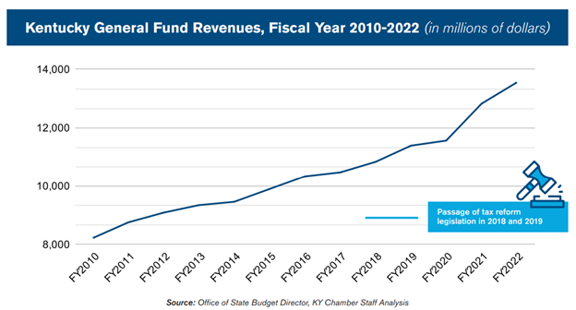
The Impact of Kentucky Tax Reform
Notes:
Interestingly, these reforms have not only had positive impacts on Kentucky’s economy but they have resulted in increased state revenues due to the growth of our economy.
This is in direct contradiction to opponents of tax reform who said it would starve the state of resources
One of the areas where revenues have grown the most is in corporate taxes

Slide 10
Where Are We Not Rising to Our Full Potential?
Notes:
So, we are seeing strong signs of economic growth as many of the pro-business policies passed by the General Assembly over the past five years have gone into effect.
Nonetheless, we also know that there are key areas that still need a great deal of attention.

Slide 11
Kentucky’s Workforce Crisis
Notes:
One of the most dire areas of need is with Kentucky’s workforce
The Chamber has been aggressively highlighting this issue for several years and published a major report on the challenge in 2021 titled 20 Years in the Making: Kentucky’s Workforce Crisis
Throughout the economic recovery, this crisis has really entered into the limelight
This chart helps explain why the challenge has become so pressing.
The blue line represents the number of open jobs in Kentucky as of May 2022 – roughly 170,000 open jobs
The red line represents the number of unemployed Kentuckians looking for a job – roughly 80,000
Ordinarily, these two lines are fairly close to each other, like what you can see prior to the pandemic.
Today, however, there are more than 2 open jobs for every unemployed Kentuckian looking for a job

Slide 12
Kentucky’s Workforce Crisis
Notes:
One of the reasons it’s so hard to hire in Kentucky is because of our low workforce participation rate
As of June 2022, Kentucky’s workforce participation rate was 58.1 percent. This is the seventh lowest in the nation. Throughout the recovery, our workforce participation rate has fluctuated but it has consistently been in the bottom 10 states.

Slide 13
Kentucky’s Workforce Crisis
Notes:
Low workforce participation is nothing new in Kentucky. We been in the bottom 10 since the mid 1980s.
As we highlighted in our workforce report from last year, our workforce participation rate has actually been declining since the early 2000s.
This crisis is by far one of Kentucky’s greatest economic challenges.
Few businesses are willing to enter into a market where they won’t be able to hire, and difficulties in finding qualified staff will make it harder and harder for Kentucky employers to growth and thrive

Slide 14
Recent Progress & Next Steps
Unemployment Insurance Reform
Employee Child Care Assistance Program
Criminal Justice Reforms
Kentucky Workforce Center
Next Step: Substance Abuse and Re-entry
Next Step: Post-Secondary Attainment
Notes:
Fortunately, the General Assembly has made some good progress in this area recently.
In 2021, lawmakers reformed our unemployment insurance system to support rapid re-employment; created a new program called the Employee Child Care Assistance Partnership to encourage more employers to include child care assistance in their employee benefit packages; and passed important legislation to reform Kentucky’s criminal justice system to support to workforce participation
In addition, the Kentucky Chamber Foundation launched the Kentucky Chamber Workforce Center to drive business-led solutions to the workforce crisis
Nonetheless, much more remains to be done.
In particular, we need to hone in on addressing Kentucky’s substance abuse issues and doing more to support successful re-entry for low-level offenders
We also need to do more to support post-secondary attainment. Upwards of 60 percent of jobs today require some level of post-secondary training, while our post-secondary attainment rate among prime-age workers is closer to 50 percent.
In our 2021 workforce report, the Chamber highlights a whole range of different policy recommendations for legislators to pursue

Slide 15
Improving Kentucky’s Tax Competitiveness
Notes:
Another key area is continuing to improve Kentucky’s tax competitiveness
I already mentioned the important reforms of 2018, 2019, and 2022, but it’s important to re-emphasize the importance of continuous improvement when it comes to our tax code
There are two key reasons for this:
First, Kentucky is uniquely situated in a highly competitive regional tax environment. With Indiana to our north and Tennessee to our south, we are sandwiched between two of the most competitive state tax environments in the nation. Not far away are Florida and North Carolina. If you are a business looking to expand in or into the Midwest or Southeast, it is difficult for Kentucky to compete with those states.
Second, other states are actively improving the competitiveness of their tax codes. Just last year, nearly two-dozen states implemented pro-growth reforms, including states like Indiana, Missouri, and Ohio.
adf

Slide 16
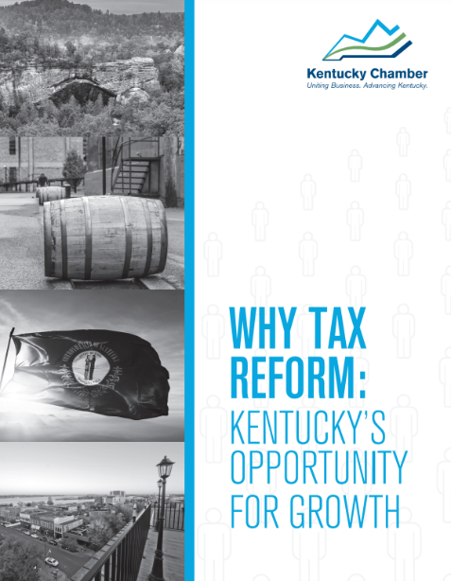
Improving Kentucky’s Tax Competitiveness
Follow through on House Bill 8
Repeal the Limited Liability Entity Tax
Improve Tax Treatment of Business Investments
Reform Local Taxation
Ensure the Competitiveness of Sales Tax Base
Notes:
Fortunately, we know many of the steps we need to take
Last year, the Chamber partnered with the Tax Foundation to get their feedback on what specifically Kentucky needs to do. The Tax Foundation came back with about 70 pages worth of reforms and why they are important. In turn, the Chamber distilled these recommendations into a handful that we argue are the most important and compiled them into a report released earlier this year titled Why Tax Reform: Kentucky’s Opportunity for Growth.
Key reforms include:
Following through on House Bill 8 to phase out Kentucky’s individual income tax
Repealing the Limited Liability Entity Tax. This is a tax that raises minimal amounts of revenue but creates administrative burdens for employers and makes Kentucky an outlier.
We need to improve how Kentucky’s tax code treats capital investments by business. Increasing business investment is obviously a good thing, and we need to follow in the steps of states like Oklahoma, which have aligned their treatment of capital investments with reforms at the federal level
We need to reform our local tax code. Even if we are successful in phasing out Kentucky’s individual income tax through House Bill 8, Kentucky won’t truly be an income-tax-free state because we still have occupational licensing taxes at the local level. We need to give local governments the ability to decrease their reliance on the OLT, which will be better for Kentucky as a whole.
Finally, we need to ensure the competitiveness of our sales tax base. Reducing income taxes will inevitably involve expanding the sales tax base, but it is important that we not make Kentucky an outlier, not put small businesses in Kentucky at a disadvantage, and that we avoid applying the sales tax to business inputs

Slide 17
Kentucky’s Progress & Potential
Notes:
In sum, Kentucky’s economic future is looking bright, we are already see strong signs of progress due to the pro-growth policies enacted during the last five years; and this is something the Chamber will actively monitor and discuss in the coming years.
However, we still have important work to do especially in the areas of workforce participation and ensuring a competitive tax climate

