Slide 1
How to Use Social Media The Good, the Bad and the Ugly

Slide 2
Instagram, Facebook, Twitter and Tik Tok are some of the main social media platforms

Slide 3
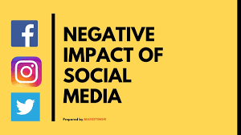
The negative effect of using social media, what is appropriate and what is not appropriate to post.

Slide 4
Have You Paid the Proper Attention to Your Online Reputation?
Invisibility indicates that you’re not up to speed with technology and the online world.
Biggest turnoffs: inappropriate photographs/videos, signs that the candidate is binge drinking or using drugs, bigoted comments related to race, religion, gender, bad mouthing of previous employers or fellow employees, and poor communication skills.
Confidential Information and Job Offers
Plagiarism
Untruthful Information on Qualifications
Posts on Alcohol and Drug Use
Nude Photos
Cyberbullying
Employer or Company Complaints
Job and Customer Complaints
Inappropriate and Profane Remarks
Spelling and Grammar Flaws

Slide 5
Things Not to Post: Obscene Threatening Intimidating Harassing Bullying

Slide 6
More Things Not to Post: Racial Ethnic Sexual Religious Physical Disability Slurs Not brand endorsements

Slide 7
Social Media Impact on Employment
60% of employers use social networking sites to research job candidates, this is up from only 11% a decade ago.
Tools such as Facebook/Twitter enable employers to get a glimpse of who their candidates are outside the confines of a resume or cover letter.
More than 2 in 5 employers said they are less likely to interview job candidates if they’re unable to find information about the person online.
Nearly half of hiring managers who screen candidates via social networks said they’ve found information that caused them not to hire a person.

Slide 8
Here are Five Things You Need to do:
Know your digital identity
Your first task is to know what’s out there. So do what employers do when they begin researching you online. Conduct a basic search of your name and its variations, such as with and without your middle name or initial.
Be creative in drilling down to material about yourself – try your name plus your school or hometown or last employer.

Slide 9
Scrub the Social Media Pages that are Yours
Look over everything on your social media timelines and remove any dirt that you wouldn’t want employers to see. If you can’t delete it yourself, contact the site manager and request to have it removed.
Check out Facebook posts that you’re tagged in and un tag yourself if the post contains any content, including photos, that is unprofessional.
On Twitter, you can review mentions on your profile name and discover tweets by others that mention you. If you can't remove an uncomplimentary comment or photo, you can at least prepare a response should a potential employer ask you about it.

Slide 10
Keep tabs on your pals
Keep an eye on what others are posting on your profile and what you're tagged in. Consider asking for cooperation from people who are serial offenders in terms of putting up offensive stuff.

Slide 11
Fine – Tune Your Privacy
Though you want to be visible online to a potential employer, every social media and networking channel has privacy settings that let you restrict how visible you are. In some cases, you can limit what other people share about you.
Social media sites change their privacy systems often, and sometimes this leads to a change in your personal settings. It’s good practice to review the privacy settings for all of your accounts regularly.

Slide 12
Be Active on the Platforms You’ve Committed to
Make a point of posting comments or articles, retweeting or sharing on your social media sites daily to keep them current and relevant. This shows that you’re up to speed with your industry and connected with leaders in your field. Be certain, though, that the content you’re sharing (or even clicking “Like” on) supports the image you want to deliver to a potential employer.
Adding fresh content regularly has a second payoff: It helps assure that when someone searches for you by name, the top of the search results page will include links to content that you posted.
Hiring managers look for a proper professional image, but they also want to get a bead on what makes you run and your level of comfort and engagement on social media channels.
About a third of employers who screen candidates via social networks found information that caused them to hire a candidate, according to LinkedIn, and this included content that showed personality and interests confirming the person was a good fit for the company culture.

Slide 13
Employer Side:
While social media sites are sharing platforms and a source of entertainment, college graduates and employers are now leveraging its power. These days, it’s not uncommon for employers and job seekers alike to spend an ample amount of time on social media sites to boost their hiring efforts.
An applicant’s credentials and job interview results just don’t cut it anymore. Facebook, Twitter and LinkedIn posts, for example, have become a revolutionary tool, changing the way companies view and ultimately choose their employees.

Slide 14
Employer Side:
Companies utilize social media sites for promotions and marketing, enabling the audience to find significant information on their products and services. Social media sites are also a medium informing job seekers about current job openings. Employers that use social media for recruitment purposes are able to target a broader market of potential candidates for their job positions.
65 % of companies said that social media posts have helped them research thoroughly on their applicants’ qualifications. Some 51% of them utilize these public posts to check if the applicant is appropriate for a certain position or is flexible enough to adjust to the work environment and culture of the company.

Slide 15
Pro’s and Con’s
73% of Americans use at least one of eight popular social media platforms, which include Facebook, Twitter, Instagram and Snapchat. Social Media can certainly be a benefit to a company marketing efforts when used appropriately, social media use can also be a drain on employee’s productivity. Therefore, when it comes to creating a social media policy for the workplace, take a good look at the pros and cons of its use.
PROS | CONS
Company Publicity | Image Risk
Morale Boost | Lost Productivity
Builds Relationships

Slide 16
Publicity:
Social media for your company allows you to connect with your consumers or audience, enhance your brand, bring attention to your products or services and network with like-minded people, both locally and nationally.

Slide 17
Image Risk:
The company is at risk of developing a poor image. All it takes is one poorly timed Tweet or a Facebook post that can be misinterpreted and the organization could make the local or even national news.

Slide 18
Morale Boost: Lost Productivity:
Social media use allows the employees to take short breaks throughout the day, which can actually boost productivity. Rather than going outside or to the break room, employees are able to simply take a quick mental hiatus from work while still sitting at their desks.
11% spent more than an hour on social media every day at work, outside of their lunch break. They then took the average hourly wage into account and determined that the one hour per day adds up to $128.45 a week and $6,422.50 in lost productivity over the course of a year.

Slide 19
Builds Relationships:
The use of social media in the workplace can build strong relationships, either between employees and customers or clients and between employees. When co-workers have stronger personal relationships, they often work more efficiently as a team. They might also begin to see their co-workers as friends, which can increase their satisfaction in coming to work every day.

Slide 20
What are Employers Looking For?
When searching social networking sites, the employers surveyed reported four main things they are vigilant for:
Information that supports a candidate’s qualifications.
The professionalism of a candidate’s online persona.
What other people are posting about candidates.
A reason not to hire a candidate.

Slide 21
What Factors Lead to Rejection?
Here are the top 11 things employers said caused them to reject candidates, according to CareerBuilder:
Provocative or inappropriate posts or information.
Drinking or using drugs.
Discriminatory comments related to race, gender or religion.
Bad-mouthing their previous company or fellow employee.
Lying about qualifications.
Poor communication skills
Links to criminal behavior.
Sharing confidential information from previous employers.
Unprofessional screen name or handle.
Lied about an absence.
Posted too frequently.
Without a social media presence, 57% of employers say they won’t even consider candidates.

Slide 22
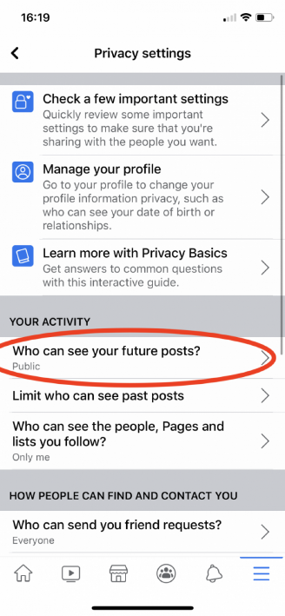
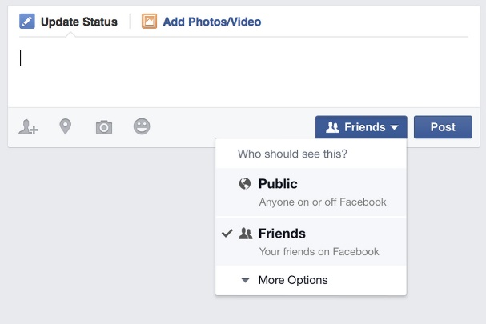
Privacy Settings

Slide 24
