Slide 1
Financial Management
Notes:
Today, we are going to discuss finances. Personally, this is a topic I’ve struggled with for a long time. I can relate to the struggle of having money for bills, being in debt, and the pain of struggling to find a way out. I hope today will help you know you are not alone, support and help is available, and I’m here to do my best to share from my experience.

Slide 2
Financial Management can be a very difficult topic. Finances are not always easy for everyone nor are they always manageable. Between your income, the debts you have, your bills, it can be extremely overwhelming. I can definitely relate to the struggle. I’m not here to advise you but I’m here to support you and offer general information on the topic. If you do need more assistance please reach out to a professional.

Slide 3
Where to Start?
Make a budget
Track your debts
Create a financial calendar
Less spending and more saving
Notes:
The best way to start when you are struggling financially is making a budget. It simple terms a budget shows you how much make per month, where your money goes per month for bills, and exactly what you spend your money on. So, if you spend money every week on a cup of coffee, or a candy bar, or go clothing shopping every other week, these are habits that you can break to help you develop better financially and help you save money.

Slide 4
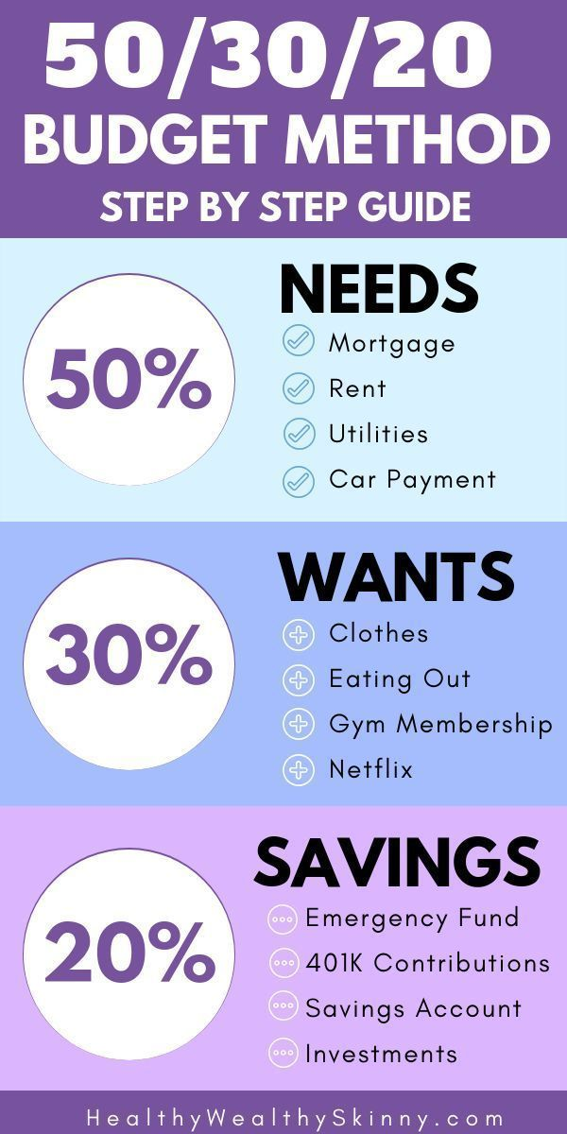
How to Budget
Notes:
So the way to budget is fairly simple.
Gather all your financial statements
Calculate your monthly income
Create a list of your monthly expenses
Determine your fixed and variable expenses
Total your monthly income and expenses
Make adjustments as needed
The chart on the right is a way to budget. So basically 50% of your income goes to towards your needs (rent, mortgage, car, utilities). 30% goes to wants such as clothing, entertainment such as going to the gym, out to eat, or to see a movie. Finally 20% goes to savings for an emergency fund, 401K, savings account, etc.

Slide 5
How to Manage Debt
It can be hard to admit to yourself how much you owe. But it’s the best way to solve the issue. Plus it will help you to see exactly what you owe, who you owe, and in time won’t seem as overwhelming.
Notes:
As I stated managing finances can be overwhelming. I’ve personally struggled most of my adult life financially. I could blame my upbringing not having anyone to teach me the basics but in reality it’s my own fault and responsibility to better manage it. So, with that being said the best to solve debt is to calculate exactly how much you owe. It will help you see who you owe, how much per month you owe, and will help you come up with a plan to pay it off. I personally start with my lowest debt and work my way up to the highest debt but do what is best for you.

Slide 6
Good Debt vs. Bad Debt
Good Debt-considered an investment for the future and has a lower interest rate.
Bad Debt-can be prevented and has a higher interest rate.
Student Loans
Mortgages
Business Loans
Consumer Loans
Credit Card Loans
Car Loans
Notes:
So, there is good debt and bad. The reason they refer to student loans, mortgages, and business loans as good is because they are considered an investment. So student loans help you gain an education and hopefully secure a higher wage and more fulfilling career. A mortgage is for your own which you can later sell for a higher price, and a business loan is for you to help start and grow your business and hopefully have it be successful so you can pay yourself back.
Bad debt such as consumer loans, car loans, and credit card debt can be prevented by simply saving the money to use instead of taking out loans that effect your credit and take more time pay off.

Slide 7
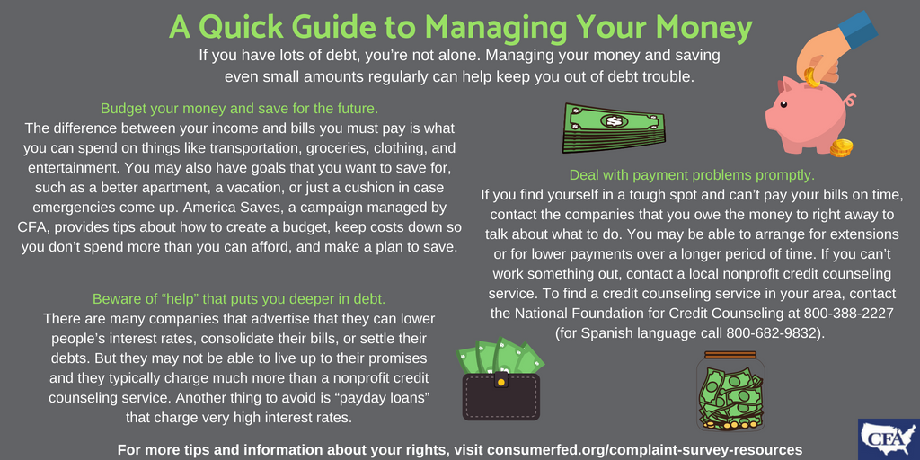
Tips to Manage Your Money

Slide 8
Spend Less, Save More
Notes:
I’ve heard the phrase “it’s not about how much you can spend but how much you can save” and I wish I had taken it more seriously. Anyone can build wealth as long as they have the discipline, responsibility, and don’t have the debt to hold them back from saving more. Here are some great tips to save.

Slide 9
Financial Peace
Notes:
Financial peace can be obtained through hard work, patience, and time. I know I’m making strides now to pay off my debts and save more for my future and I hope this has encouraged you to do the same.

Slide 10
Financial Resources
Inform your creditors and discuss options for payment plans
Reach out to a certified financial counselor for advice
Educate yourself by researching different methods, financial courses, etc.
Don’t be afraid to ask for help
Notes:
Remember you are not alone in your journey. It’s encouraged to ask for help when you are struggling. They are several resources available such as financial advisors, certified financial counselors, online courses, etc.

