Slide 1
Customer Service 2.0
Engaging Customers in a Meaningful Way

Slide 2
Who We Are
Customer Service
Intake
Citizen Connect and Focus Registration
Menu of Services
Routing Customers
Referrals
Activities in Staff Connect
Mock examples

Slide 3
A one-stop solution for employers and job seekers

Slide 4
TENCO Workforce Development Board
Mission statement
Mission Statement
Our mission is to assist community and industry leaders, as well as economic developers, to facilitate positive solutions for workplace issues, and to improve the economic well-being of the region.
Vision Statement
The TENCO Workforce Development Board works to create a highly skilled, knowledgeable and creative workforce that attracts new businesses and enhances the success of existing businesses, resulting in additional employment opportunities at competitive wages.
Notes:
Graphic showing how we all fit together
WIOA act overview – we all work under the same goal under this law

Slide 5
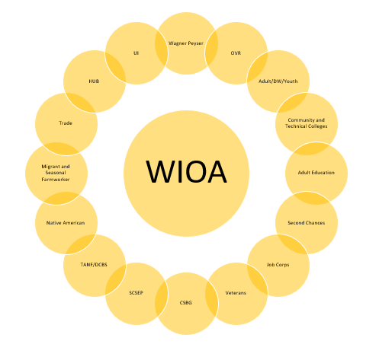

Slide 6
https://youtu.be/cHW0R_BDDeM
Notes:
KCC Overview Video

Slide 7
BOTTOM LINE
We are here to connect people with jobs to improve our community.

Slide 8
They expect to get a job with our help
Notes:
When customers visit KCC’s they expect we can help them get a job, receive training, or meet whatever need they have.
We can provide:
Localized labor market information.
Information on job leads
Counseling to match their interests, skills and experience
One-on-one assistance with writing a great resume and cover letter or completing applications.
Help in giving employers the best first impression

Slide 9
Customer Service
https://www.youtube.com/watch?v=ISJ1V8vBiiI

Slide 10
Intake
Everyone needs to sign in, even if they are just dropping forms off. We need to be able to contact them later.
Customer needs to complete the front portion of the intake slip, front desk staff will mark the services provided on the back of the slip. The information will be entered into the intake spreadsheet.
This Photo by Unknown Author is licensed under CC BY
Notes:
Be consistent in how information in entered. Make sure to mark DVOP, OVR as appropriate
Use comments to record information not captured in other columns.
DVOP flow chart

Slide 11
Citizen Connect
All customers should register for a Citizen Connect Account.
With a Citizen Connect account, customers will be able to check their SNAP and Medicaid Benefits
Counselors can assign the customer Registration and Assessment
Customer can upload documents
Notes:
Kevin Dingess

Slide 12
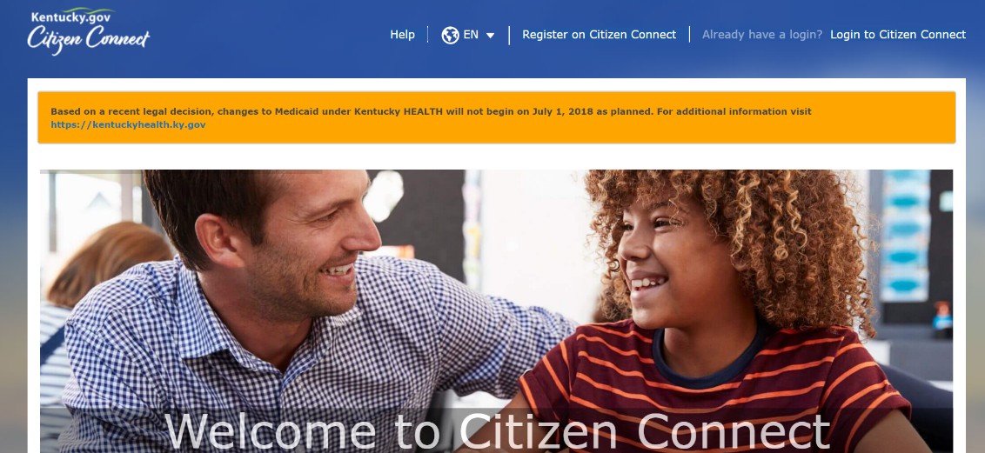
Citizen Connect
Citizen Connect is a website for Kentucky HEALTH, SNAP Employment and Training (E&T) recipients and individuals looking for employment.
Citizen Connect
Request Appointments to meet with KCC Staff
Search for local Community Engagement opportunities
Take free online courses to earn My Rewards dollars
For more information, please see a Workforce Case Manager or visit CitizenConnect.ky.gov

Slide 13
Focus Career
Access Job Posting from across the state
Develop resume
Explore labor market information

Slide 14
Job Registration
Whether you are unemployed or looking for a new career opportunity, Focus Career provides both a professional resume builder and a path to job registration.
Get started today at: focuscareer.ky.gov

Slide 15
Job Registration
Focus Career allows you to:
build a professional resume easily, using the interview wizard;
find job leads instantly that match your skills and transferable abilities;
schedule job alerts daily or weekly to your inbox; and
explore career options and paths to reach your education and employment goals.

Slide 16
Notes:
Menu of services
Use new VR board slides

Slide 17
Services Available
Career exploration
Job search
Veterans express
Registering as a job seeker

Slide 18
Services Available
Assistance with resumes
Computer skills training
Assistance with interviewing
Skill level testing
Talk to a career counselor today.

Slide 20
Veterans
You have served us. Now let us serve you.
You may qualify for special assistance if you have served in the military or you are the spouse of a veteran. Let us know!

Slide 21
Job Seekers
WIN Career Readiness Certification
Earn a workplace skills credential by taking training and assessments:
Applied Mathematics
Locating Information
Reading for Information

Slide 22
Job Seekers
Kentucky Essential Skills Certification
Earn a certificate by taking the training and assessments for in demand soft skills employers are asking for:
Promoting Teamwork & Collaboration
Conveying Professionalism
Communicating Effectively
Thinking Critically & Problem Solving

Slide 23
Job Seekers
ACT's National Career Readiness Certificate ® (NCRC ®) is a portable credential demonstrating workplace employability skills.
Individuals can earn the NCRC by taking three WorkKeys® assessments.
Applied Math
Graphic Literacy
Workplace Documents

Slide 24
Job Seekers
WorkKeys assessments measure real-world skills that employers believe are critical to job success. Test questions are based on everyday workplace situations in the real world.
Talk to a Career Counselor about the NCRC.
Stand out from the crowd by
earning the NCRC.

Slide 26
Vocational Services
The Kentucky Career Center helps Kentuckians with disabilities achieve suitable employment and independence.
Whatever your disability, we work with you on an individual basis to assist you in reaching your goals. This includes specialized services for the blind.
It all starts with a one-on-one meeting with you to determine whether you are eligible for our services.

Slide 27
Vocational Services
Among the variety of services we offer:
assessment for determining eligibility and vocational rehabilitation needs
counseling and guidance
vocational and other training services
supported employment

Slide 28
Vocational Services
Among the variety of services we offer:
personal assistance services
transition services (from school to employment)
support services (such as transportation, interpreter and note-taking services)

Slide 29
Vocational Services
Among the variety of services we offer:
rehabilitation technology – vehicle modifications, workplace accessibility modifications, telecommunications, sensory and other technological aids and devices
job placement and job retention services

Slide 30
Kentucky HEALTH
Kentucky HEALTH (Helping to Engage & Achieve Long Term Health) is Kentucky’s new health and well-being program for some Medicaid recipients.
Are YOU qualified?
Apply for a Kentucky HEALTH program TODAY!
Get Started Today
Visit KentuckyHEALTH.ky.gov

Slide 31
SNAP E&T Program
The Supplemental Nutrition Assistance Program (SNAP) Employment & Training (E&T) Program places SNAP participants into employment, and training programs.
How the KCC Can Help YOU!
Help you gain NEW skills, training, work or employment experience
Help you find employment and track work participation requirements
See a Career Counselor to get help on finding a job opportunity for you TODAY!

Slide 32
Training for a Better Job
You might benefit from training to learn new skills or to reinforce skills that have gotten a little rusty.
Ask us how today.

Slide 33
Training for a Better Job
Through a variety of training programs, the Kentucky Career Center helps eligible individuals find self-sustaining employment.
Training is usually offered through:
community and technical colleges
universities
private for-profit organizations
businesses
Notes:
If counselor is not available the customer needs to register on citizen connect and focus.
If customer calls, the front desk can have them start this over the phone.

Slide 34
Business Services
Recruiting
Training
Rapid response
Labor issues

Slide 35
Business Services Contacts
Business Service Coordinator
Jeremy Faulkner
Business Service Representatives
Kevin Dingess
Victor McKay
Local Veterans Employment Representative
Amanda Cummins
Career Development Office
Tonia Anderson
Notes:
How to route calls and take messages
Refer to Tonia in Morehead we have a business call

Slide 36
KET In Demand Videos
https://tencocareercenter.com/sectors/
Notes:
Discuss with staff how they can use the videos and show one during the training.

Slide 37
Other Partners
Native American Programs
Migrant and Seasonal Farmworker Program
Adult Education / Skills U
Senior Community Service Employment Program
Community and Technical Colleges
Commonwealth Opportunity Center
Goodwill Industries
Notes:
(a) Section 121(b)(1)(B) of WIOA identifies the entities that are required partners in the local one-stop delivery systems.
(b) The required partners are the entities responsible for administering the following programs and activities in the local area:
(1) Programs authorized under title I of WIOA, including:
(i) Adults;
(ii) Dislocated workers;
(iii) Youth;
(iv) Job Corps;
(v) YouthBuild;
(vi) Native American programs; and
(vii) Migrant and seasonal farmworker programs;
(2) The Wagner-Peyser Act Employment Service program authorized under the Wagner-Peyser Act ( 29 U.S.C. 49et seq.), as amended by WIOA title III;
(3) The Adult Education and Family Literacy Act (AEFLA) program authorized under title II of WIOA;
(4) The Vocational Rehabilitation (VR) program authorized under title I of the Rehabilitation Act of 1973 ( 29 U.S.C. 720et seq.), as amended by WIOA title IV;
(5) The Senior Community Service Employment Program authorized under title V of the Older AmericansAct of 1965 ( 42 U.S.C. 3056et seq.);
(6) Career and technical education programs at the postsecondary level authorized under the Carl D. Perkins Career and Technical Education Act of 2006 ( 20 U.S.C. 2301et seq.);
(7) Trade Adjustment Assistance activities authorized under chapter 2 of title II of the Trade Act of 1974 ( 19 U.S.C. 2271et seq.);
(8) Jobs for Veterans State Grants programs authorized under chapter 41 of title 38, U.S.C.;
(9) Employment and training activities carried out under the Community Services Block Grant ( 42 U.S.C. 9901et seq.);
(10) Employment and training activities carried out by the Department of Housing and Urban Development;
(11) Programs authorized under State unemployment compensation laws (in accordance with applicable Federal law);
(12) Programs authorized under sec. 212 of the Second Chance Act of 2007 ( 42 U.S.C. 17532); and
(13) Temporary Assistance for Needy Families (TANF) authorized under part A of title IV of the Social Security Act ( 42 U.S.C. 601et seq.), unless exempted by the Governor under § 678.405(b).
Open up discussion on other partners we have in centers: LIHEAP, Health Benefits Assister,

Slide 40
Activities in Staff Connect
Notes:
To enter activities for a customer. Search for them in the global search, navigate to the active workforce case, go to “Manage Activity.” After selecting NEW, you will use “Workforce Activity”
Only do activities in KEE Suite, NOT Focus.

Slide 41
You will only enter Staff Assisted Activities
Self-Service Activities are automatically captured by the system

Slide 42
Act It Out #1
Notes:
Customer is visiting KCC to file their UI claim after being terminated.

Slide 43
Act It Out #2
Notes:
Customer is visiting KCC to file their UI claim, they are a member of a hiring hall.

Slide 44
Act It Out #3
Notes:
Customer is visiting KCC after visiting DCBS, their benefits were cut for not completing the 80 work requirement.

Slide 45
Act It Out #4
Notes:
Customer is visiting KCC to turn in 858C and their counselor is not there.

Slide 46
Act It Out #5
Notes:
Customer is visiting KCC for the first time. They are currently working 2 part time jobs and they want to find a job that pays a self-sufficient wage to spend more time with their children.

Slide 47
Act It Out #6
Notes:
Customer is visiting KCC and they have limited knowledge of the English language, they are visiting after being laid off from a landscaping company.

Slide 48
Act It Out #7
Notes:
Customer is visiting KCC to file their unemployment claim, they live in Kentucky but worked in Ohio.

Slide 49
Act It Out #8
Notes:
Customer is visiting KCC to file Unemployment claim and register in Focus, they have very limited computer skills.

Slide 50
Safety
Notes:
Review information from Threat Assessments
Review Emergency Manual
Answer any questions staff might have

