Slide 1
Enhancing your Company Culture by Creating a Motivational Workforce
Presenter: Dr. Kay Combs, EdD
www.cmiconsulting.com

Slide 2
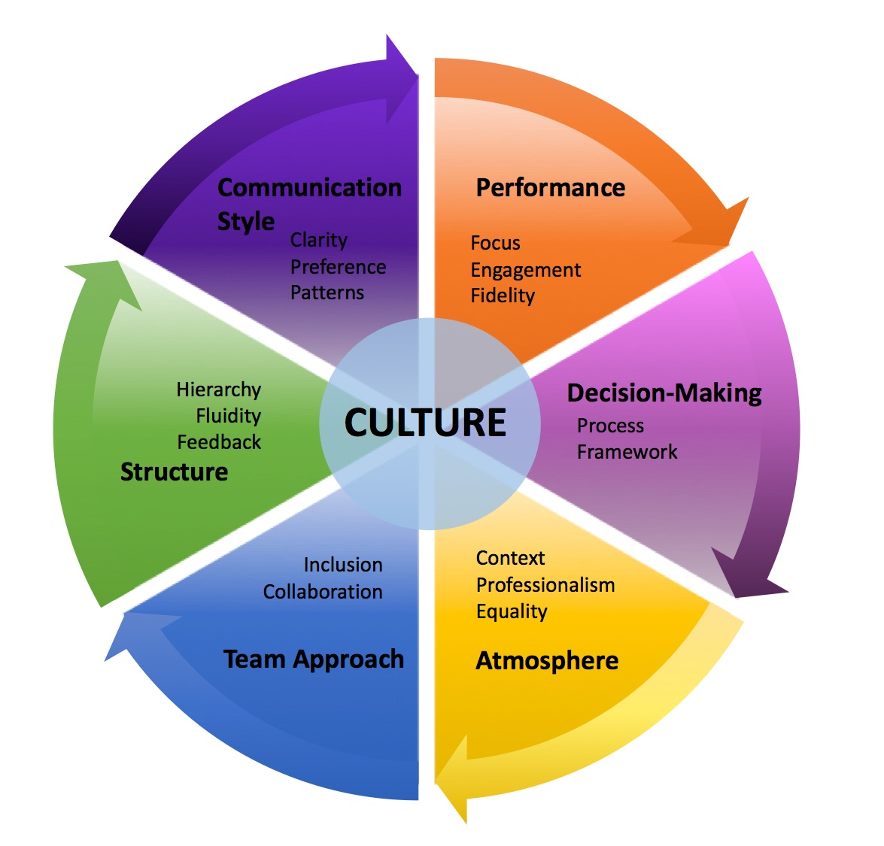
WHAT DO WE MEAN BY “COMPANY CULTURE”?
https://www.surpassyourgoals.com/wp-content/uploads/Company-Culture-Profile.jpg

Slide 3
WHAT DRIVES PEAK PERFORMANCE?
WHEN employees know WHY they work it affects how WELL they work
Great cultures = fuel total motivation = total motivation fuels performance

Slide 4
HIGH PERFORMING TEAMS HAVE TWO INGREDIENTS
Tactical Performance
How well an employee executes a plan – the productivity, efficiency and control.
Adaptive Performance
An employee or company’s ability to diverge from the plan. People and organizations need to adapt.
Great cultures with motivated employees
keep these two opposing forces in balance.

Slide 5
HOW DO YOU FUEL PERFORMANCE?
Eliminate incentive compensation and increase pay
Eliminate performance management reviews
Focus on the 3 P’s – Play, Purpose and Potential – allowing employee’s the opportunity to be creative in the work they do and make decisions to improve the work.

Slide 6
Adaptive Performance
THE 3 P’s
PLAY - Can you tell if your employee’s enjoy being at work? Do you provide opportunities for creativity and decision making?
PURPOSE - What is the employee’s purpose for being at your company? Do they know and understand their value?
POTENTIAL - Do you know the potential of your employee? Does your employee know what the future holds for them at your company.
TO HAVE MEANINGFUL WORK IS TREMENDOUS HAPPINESS
Rita Mae Brown
Researchers have shown that by “allowing experimentation” and “encouraging novelty,” leaders create adaptive performance.

Slide 7
STRATEGIES TO IMPLEMENT ADAPTIVE PERFORMANCE
Provide feedback to your employees –
allow employees to provide feedback on your performance
Take time to listen to your employees
Encourage learning within your employees –
developing employees’ abilities allows employees to believe in their potential
Provide opportunities for employees to make decisions
Create Vitality in your employees –
employees need to know that what they do makes a difference
Implement a “reflection team huddle”
Once a week meet with your team and ask:
PLAY: What did you learn this week?
PURPOSE: What impact did you have this week?
POTENTIAL: What do you want to learn next week?
Positive relationships = Positive Rewards

Slide 8
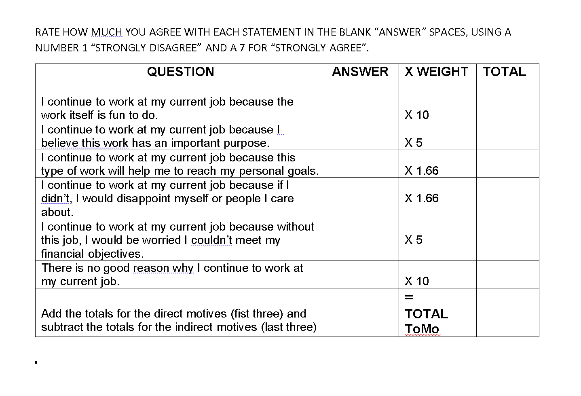
TOTAL MOTIVATION - What is your Organization’s TOMO?
Total Motivational Factor Analysis
Online TOMO Survey

Slide 9
YOU CAN ENHANCE MOTIVATION IN YOUR WORKFORCE
WE CAN CHANGE COMPANY CULTURE and PROVIDE MEANINGFUL WORK
IF WE CHANGE BEHAVIOR
859.296.2800 l cmiconsulting.com

